Slide 1
Stok barang toko bangunan

Slide 2
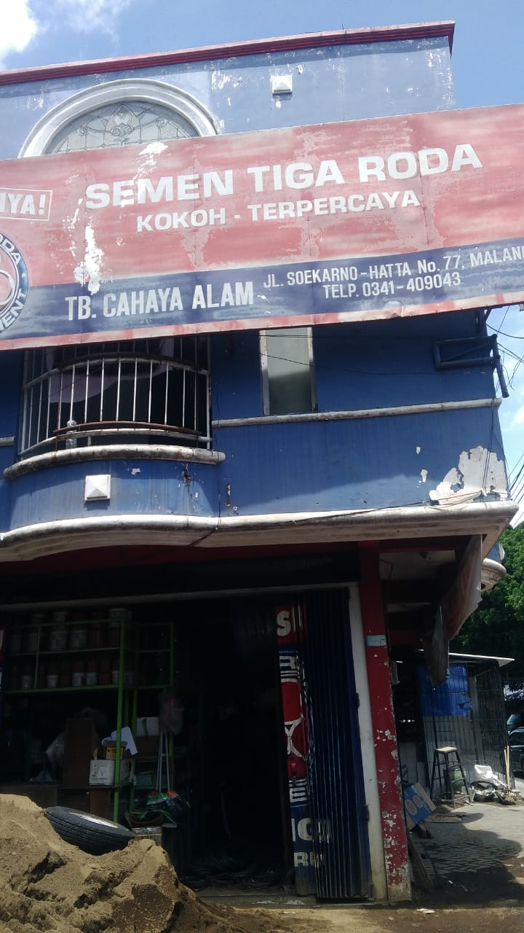
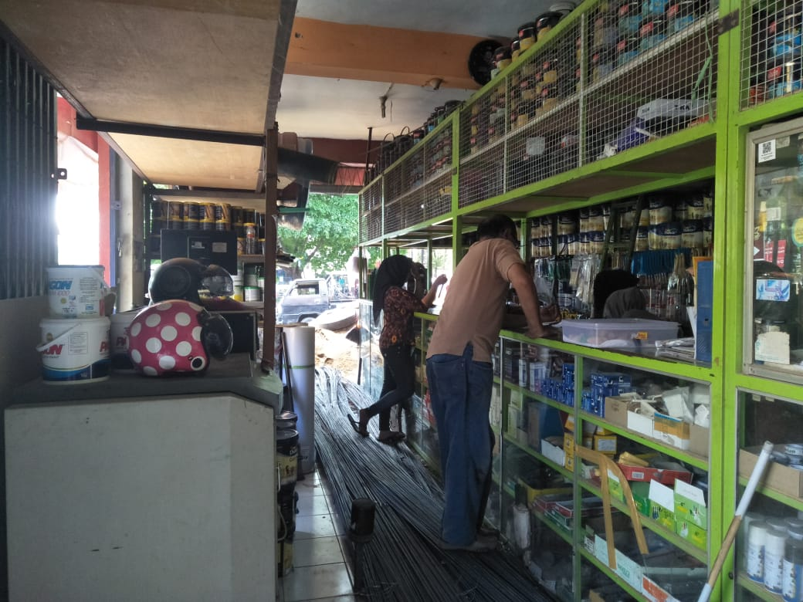
lokasi
TB.CAHAYA ALAM
Jl. Soekarno Hatta No. 77 Malang

Slide 3
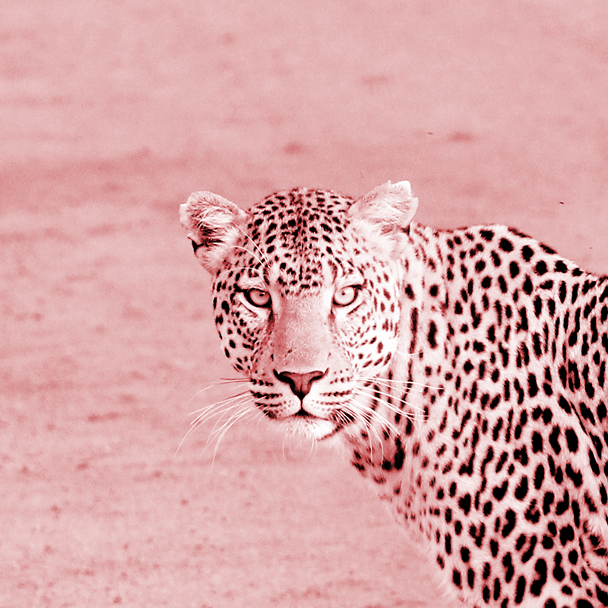
Hello!
Program ini dibuat dengan tujuan agar penjual mengetahui stok barang apa saja yang ada di toko tersebut, dan dapat menginputkan nya tidak secara tertulis tetapi langsung masuk ke program

Slide 4
Data yang digunakan
List barang berdasarkan jenis
Tanggal masuk
Jumlah barang
Harga pembelian
Harga penjualan
Nama supplier
Barang di TB. Cahaya Alam re-stock secara berkala setiap 1 minggu sekali

Slide 5
Alur program
Barang masuk dari supplier sesuai permintaan penjual
Barang yang masuk akan diinputkan manual kedalam program
Pengecekkan kecocokan data pada program dan barang real

Slide 6
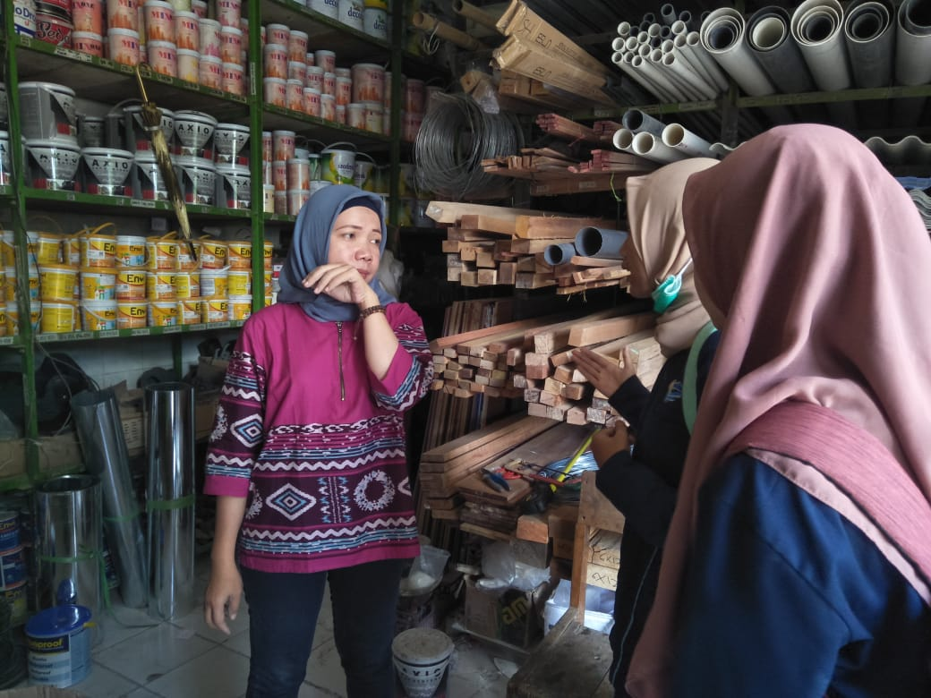
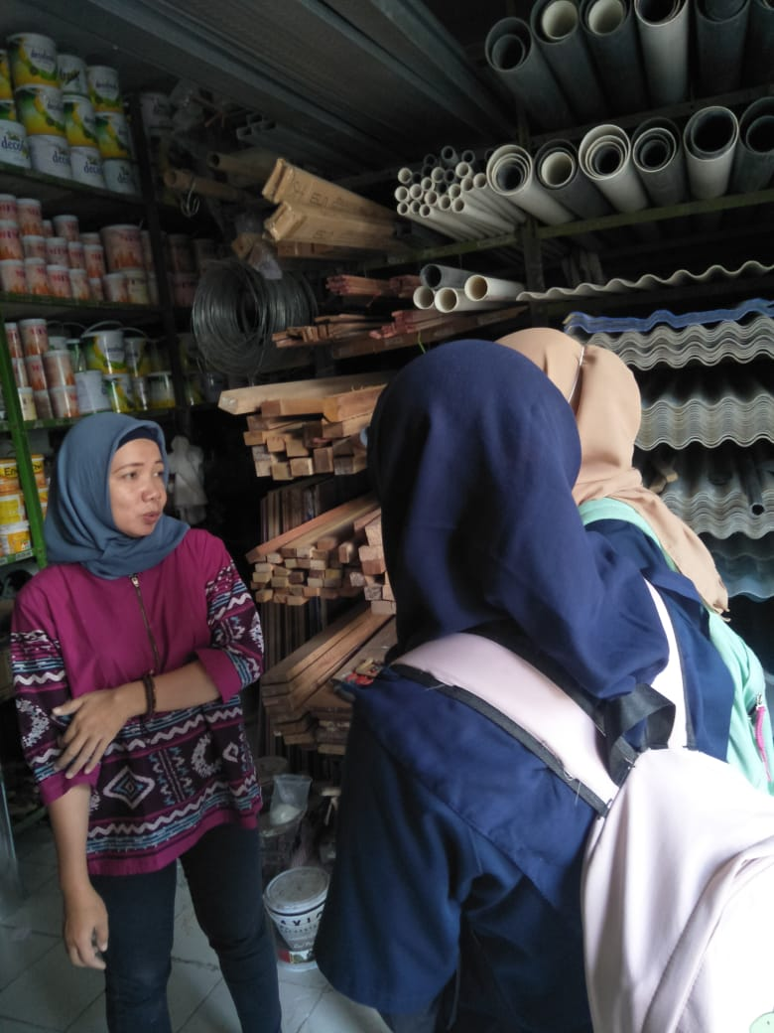
Dokumentasi survei

Slide 7
1.
Transition headline
Let’s start with the first set of slides

Slide 8
Quotations are commonly printed as a means of inspiration and to invoke philosophical thoughts from the reader.

Slide 9
You can also split your content
White
Is the color of milk and fresh snow, the color produced by the combination of all the colors of the visible spectrum.
Black
Is the color of coal, ebony, and of outer space. It is the darkest color, the result of the absence of or complete absorption of light.

Slide 10
In two or three columns
Yellow
Is the color of gold, butter and ripe lemons. In the spectrum of visible light, yellow is found between green and orange.
Blue
Is the colour of the clear sky and the deep sea. It is located between violet and green on the optical spectrum.
Red
Is the color of blood, and because of this it has historically been associated with sacrifice, danger and courage.

Slide 11
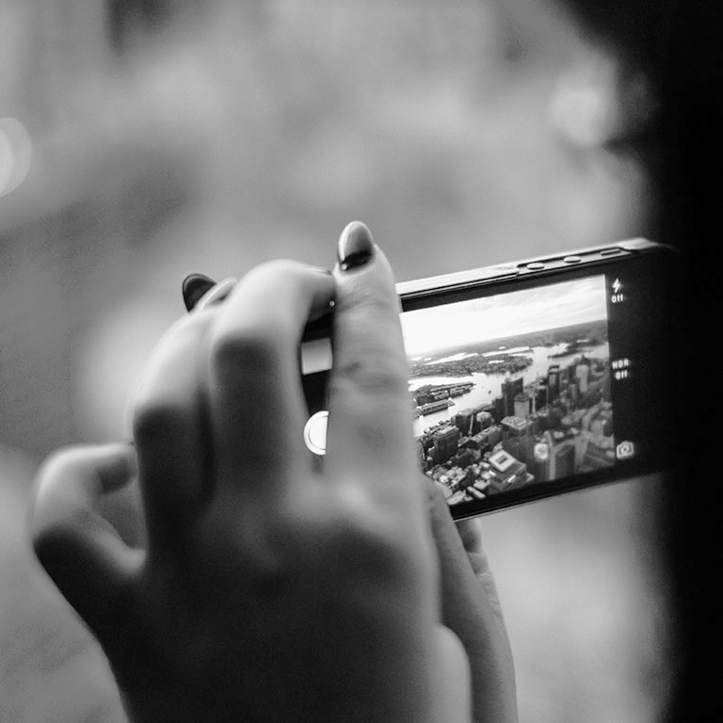
A picture is worth a thousand words
A complex idea can be conveyed with just a single still image, namely making it possible to absorb large amounts of data quickly.

Slide 12
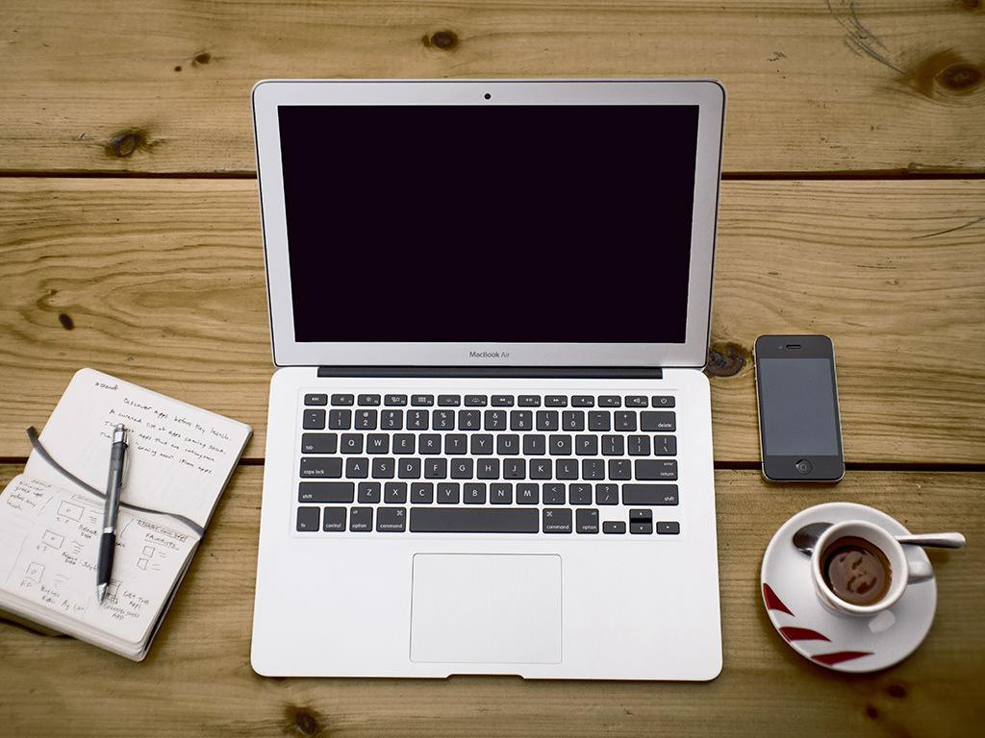
Want big impact
Use big image.

Slide 13
Use charts to explain your ideas
White
Gray
Black

Slide 14
Or use diagrams to explain complex ideas
120
80
160
40
200
MPH
0
km/h
240
9
9
9
9
9
Diagram featured by http://slidemodel.com

Slide 15
And tables to compare data
 | A | B | C
Yellow | 10 | 20 | 7
Blue | 30 | 15 | 10
Orange | 5 | 24 | 16

Slide 16
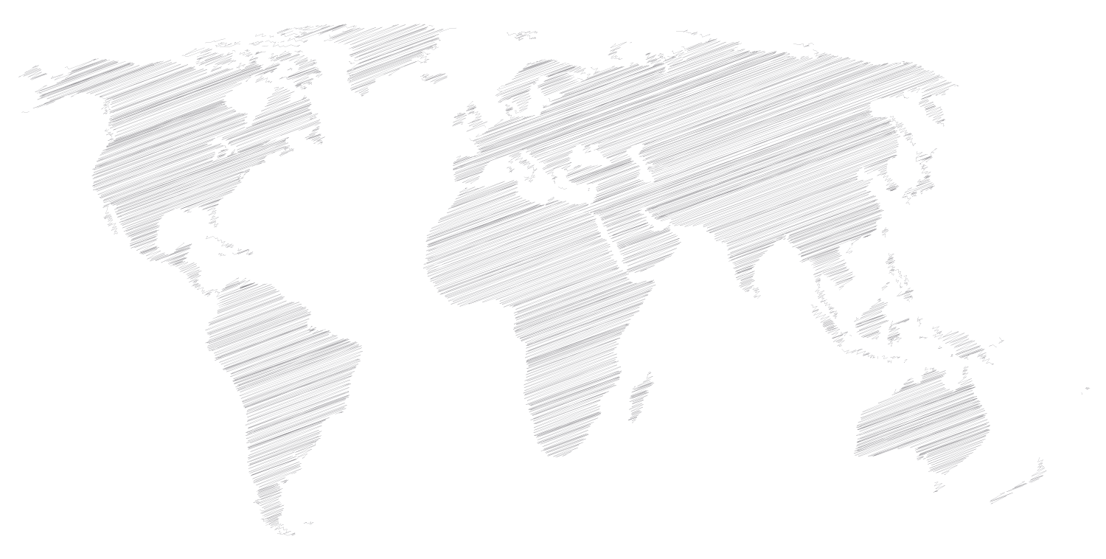
Maps
our office

Slide 17
89,526,124
Whoa! That’s a big number, aren’t you proud?

Slide 18
89,526,124$
185,244 users
100%
That’s a lot of money
And a lot of users
Total success!

Slide 19
Let’s review some concepts
Yellow
Is the color of gold, butter and ripe lemons. In the spectrum of visible light, yellow is found between green and orange.
Blue
Is the colour of the clear sky and the deep sea. It is located between violet and green on the optical spectrum.
Red
Is the color of blood, and because of this it has historically been associated with sacrifice, danger and courage.
Yellow
Is the color of gold, butter and ripe lemons. In the spectrum of visible light, yellow is found between green and orange.
Blue
Is the colour of the clear sky and the deep sea. It is located between violet and green on the optical spectrum.
Red
Is the color of blood, and because of this it has historically been associated with sacrifice, danger and courage.

Slide 20

You can copy&paste graphs from Google Sheets

Slide 21
Place your screenshot here
Android project
Show and explain your web, app or software projects using these gadget templates.

Slide 22
Place your screenshot here
iPhone project
Show and explain your web, app or software projects using these gadget templates.

Slide 23
Place your screenshot here
Tablet project
Show and explain your web, app or software projects using these gadget templates.

Slide 24
Place your screenshot here
Desktop project
Show and explain your web, app or software projects using these gadget templates.

Slide 25
Thanks!
Any questions?
You can find me at:
@username
user@mail.me

Slide 26
Credits
Special thanks to all the people who made and released these awesome resources for free:
Presentation template by SlidesCarnival
Photographs by Unsplash

Slide 27
Presentation design
This presentations uses the following typographies and colors:
Titles: Amatic SC
Body copy: Merriweather
You can download the fonts on these pages:
https://www.fontsquirrel.com/fonts/amatic
https://www.fontsquirrel.com/fonts/merriweather
Light gray #f5f6f7
Dark gray #95a5a6
Navy #2c3e50
Salmon #f55d4b
You don’t need to keep this slide in your presentation. It’s only here to serve you as a design guide if you need to create new slides or download the fonts to edit the presentation in PowerPoint®

Slide 28
SlidesCarnival icons are editable shapes.
This means that you can:
Resize them without losing quality.
Change fill color and opacity.
Isn’t that nice? :)

Slide 29
😉
Now you can use any emoji as an icon!
And of course it resizes without losing quality and you can change the color.
How? Follow Google instructions https://twitter.com/googledocs/status/730087240156643328
✋👆👉👍👤👦👧👨👩👪💃🏃💑❤😂😉😋😒😭👶😸🐟🍒🍔💣📌📖🔨🎃🎈🎨🏈🏰🌏🔌🔑 and many more...

